Slide 1
Pirai infotech Assignment
Submitted by
M.Paraneetharan

Slide 2
About Project
The requirement is to build a website to get input from Students and Save/Show the data using JQuery on same page on table view. The website is user friendly and can be accessed by any user.

Slide 3
Create Forms Using HTML,CSS and JQuery
Forms to collect information from Student.
Forms includes control elements(Save).
Input Boxes.
Control Button.
Text Label field.
Table to return data.

Slide 4
FORMS
Forms are created using the form element, Following as:
<form>
Elements
</form>
All controls performed in form.

Slide 5
INPUT ELEMENTS
A list Of input elements go inside the form tags.
The General syntax of input elements is as follows:
<input type="text" id="firstname" class="tbox">
<input type="text" id="lastname" class="tbox">
<input type="text" id="Department" class="tbox">
The “id“ is a unique identifier.
The Class or ID name can be used by CSS and JQuery to perform certain task and styling.

Slide 6
Buttons
I will use Save button.
When click on the Save button view the value in table.
<button type="button" id="save”class="savebtn">Save</button>

Slide 7
TABLE ELEMENTS
Table Elements using row and column,
<tr>
<th>First Name</th>
<th>Last Name</th>
<th>Department</th>
</tr>
This field are using in inside the <table></table>.
Tr-Table row in a table.
Th-Row of cells in a table.

Slide 8
CSS STYLE
CSS using in a style of a website:
Background color,
Font style,
Table design.
Creating a style in css:
<style>elements</style>
Using a style in css:
#- identify the id,
.- identify the class.

Slide 9
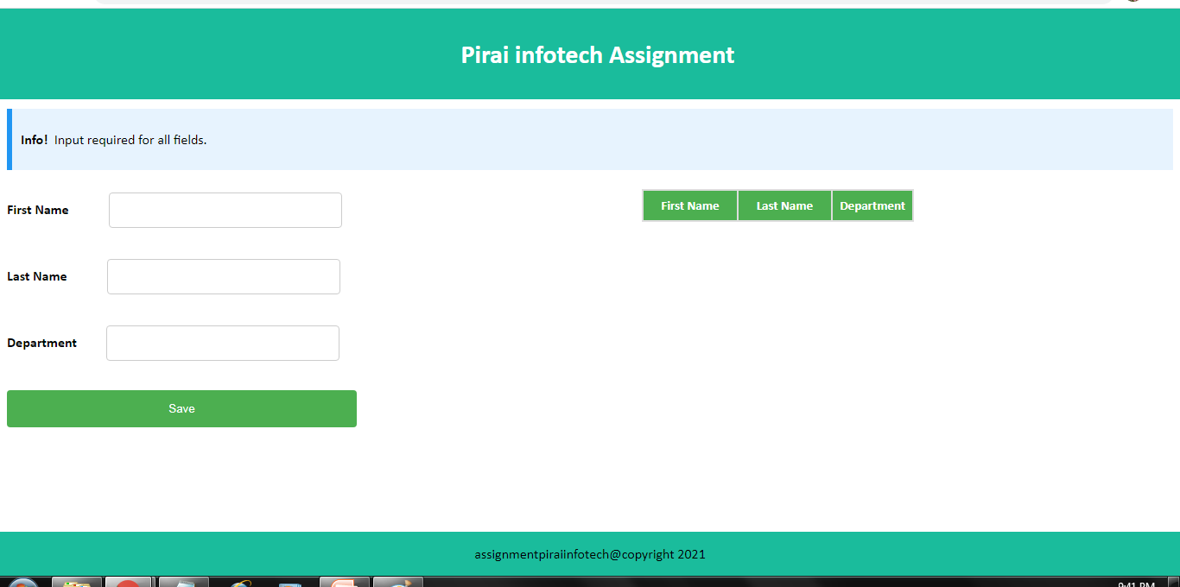
SAMPLE SCREENSHOTS

Slide 10


Slide 11
Unit Testing Result
Verified the Page contains Header and Footer.
Verified that Input field allows user to input the value.
Verify that the table is created in web page.
Verified that Save button shows the value I entered in input fields in table view.
Verified that Info message is added to let user know that they need to provide value to all input fields
Screen refresh will clear all the data entered/saved in table or form.

Slide 12
THANK YOU

